Slide 1
Shortest Path Finder using Dijkstra’s Algorithm
Name – Deepak Roll Number – 23AK1A0535
Name – Devaraju Roll Number – 23AK1A0536
Name- Dinesh Roll Number – 23AK1A0540

Slide 2
Problem Statement
Finding the shortest route manually in large networks is difficult and time-consuming.
Challenges
- Managing multiple routes and distances
Visualizing graph connections clearly
Calculating shortest paths efficiently
- Creating an interactive GUI
Need for project
This project helps users find the shortest and most efficient route between locations quickly and accurately.

Slide 3
Methodology / Approach
.Technologies Used
-Frontend -Backend
* Java Swing GUI * Java
* Buttons * Dijkstra Algorithm
* Panels * Graph Data Structure
* Graph Visualization * Route Calculation Logic
* Login Page
* Dashboard Interface
.Working Process
User selects source and destination cities.
The graph data is loaded into the system.
Dijkstra Algorithm calculates the shortest path.
The shortest route and distance are displayed.
Graph visualization highlights the selected path.

Slide 4

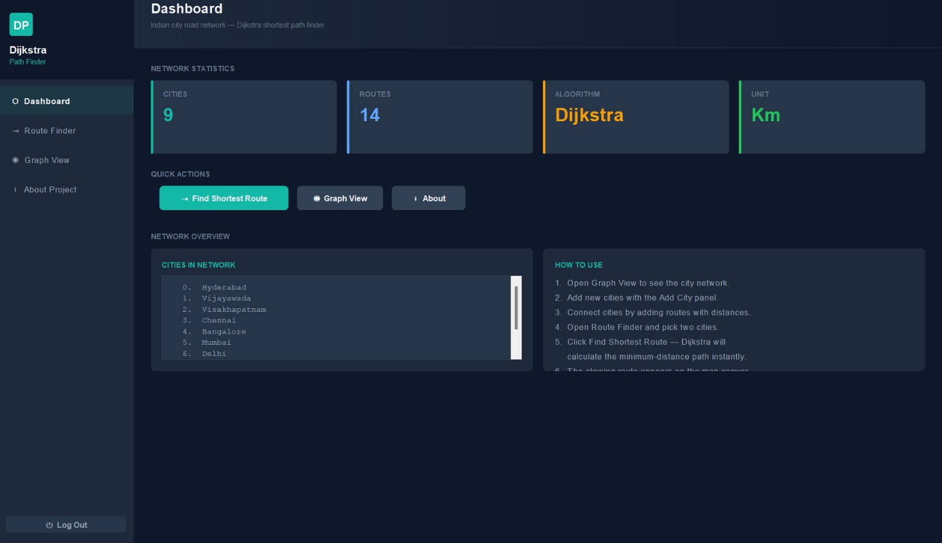
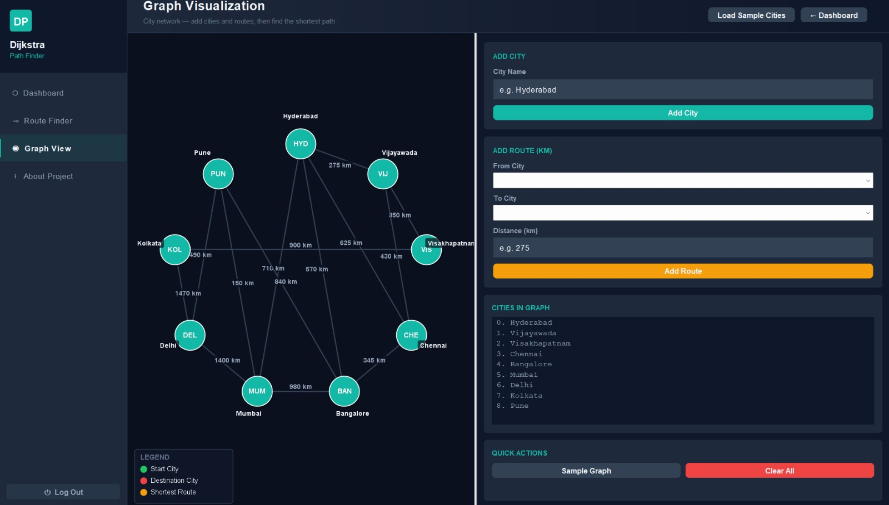
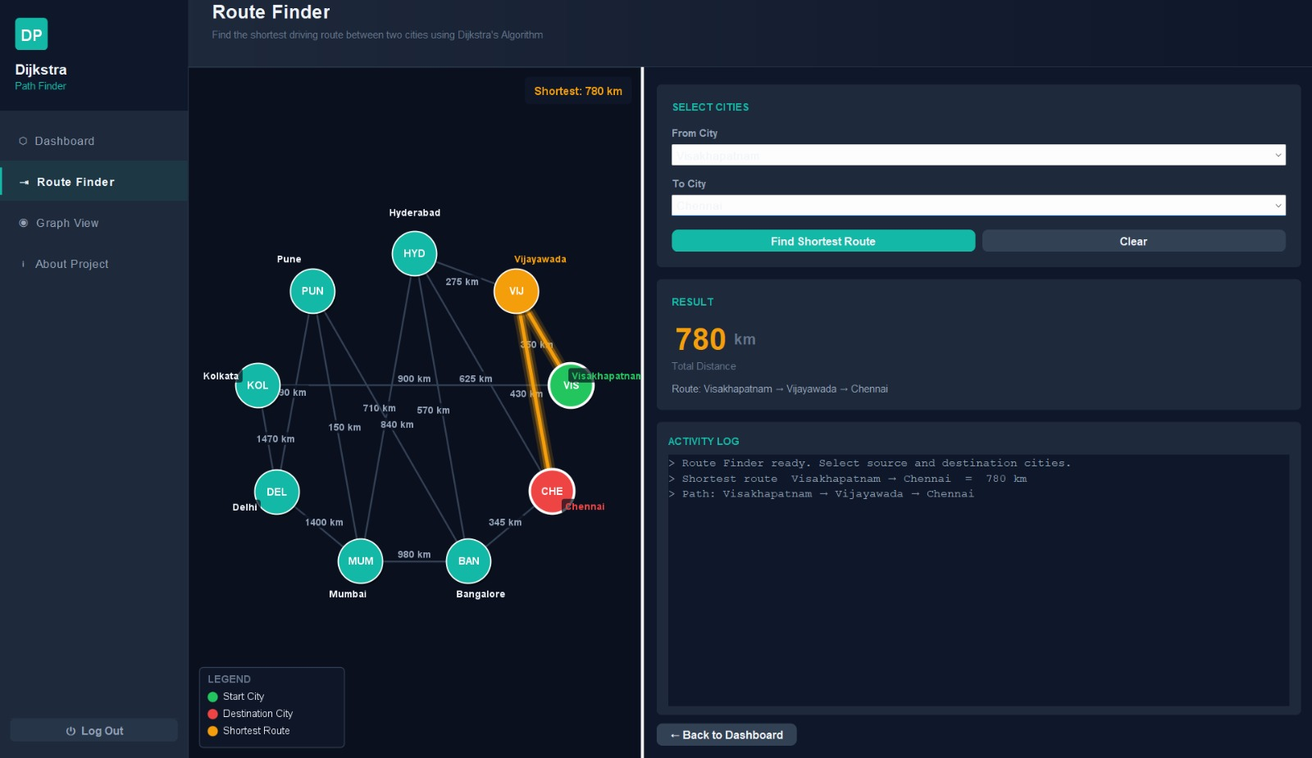
Results/Outcome

Slide 5
Conclusion
The project successfully implements Dijkstra Algorithm to find the shortest path between cities using an interactive Java Swing graphical interface
Future Enhancements
• Real map integration
• Database connectivity
• Traffic analysis
• User registration system
• Mobile application support

